Slide 1

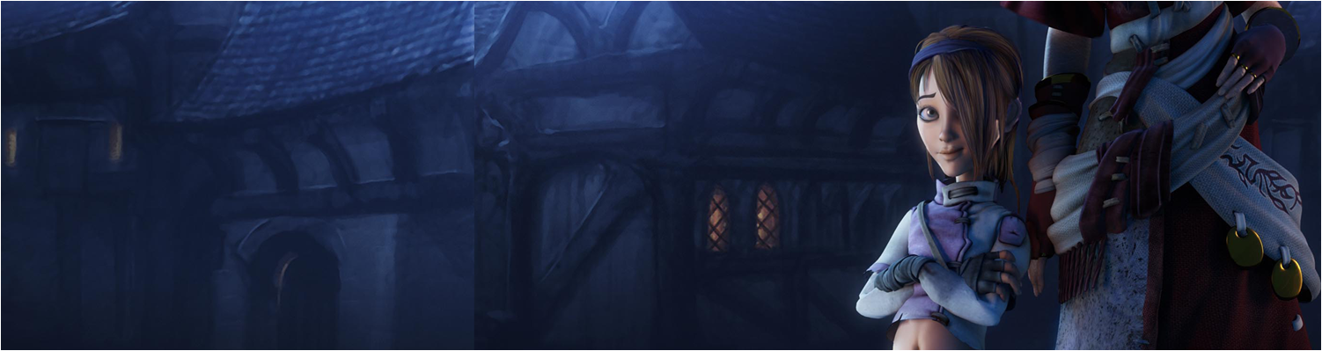

Lecture 1: Introduction
GAM150: Game Programming Essentials
BA Game Development

Slide 2
Today’s session:
Introduction to the module
Working with Unity
Break
Making Platform Games in Unity

Slide 3
Introduction to the module

Slide 4
Introduction to the module
A 12 week module to get you acclimatised to making games in Unity (2D & 3D).
Focus is on developing games rather than pure programming
For programmers & designers

Slide 5
Introduction to the module
Week 1 | Week 2 | Week 3 | Week 4 | Week 5 | Reading Week
Intro ------------------- Platform Games 1 | Platform Games 2 | Platform Games 3 (Dr. White) | Platform Games 4 | FPS Games 1 | Studio Practice
Week 7 | Week 8 | Week 9 | Week 10 | Week 11 | Week 12
Assignment Reviews ------------------- FPS Games 2 ------------------- Assignment 1 Hand-in | FPS Games 3 | FPS Games 4 (Dr. White) | Assignment Reviews ------------------- Advanced Game Development 1 ------------------- Assignment 1 Hand-in | Advanced Game Development 2 | Advanced Game Development 3 (Dr. White)

Slide 6
Introduction to the module
Module is split into 3 parts:
2D gaming where we will look at making platform games
3D gaming where we will look at making FPS games
‘Advanced game development’ where we will look at techniques for your group work in semester II.
Assignments:
2 game development assignment
Make games & submit on learning space
Perform peer review on each other’s games

Slide 7
Introduction to the module
The team
Me (Gareth Lewis)
Commercial games developer since 1994
Worked at Sony, Virgin, Acclaim, Lionhead, Kuju, Supermassive, Climax, Remode, Strike Games & Upstream Arcade
Worked on: Black & White II, Black & White, Fable, Might & Magic Dark Messiah, Blood Forge, Viva Football, Black Prophecy and more!
Unity user since 2013
Lecturer in game development since 2007
Goldsmiths, Westminster, St. Martins, Plymouth & Falmouth

Slide 8
Introduction to the module
The team
Jamie White
Lecturer in Unreal & Unity, & game development
PhD in VR
Jamie’s workshops are on a different day / time to mine
Check your timetables!

Slide 9
Introduction to the module
The team
Paul Hedley
Games Academy Technician
Runs the GAM110 Unity Use workshops
Mon (1500-1700)
Tues (0900-1100)
Will give you different perspectives in using Unity

Slide 10
Working with Unity

Slide 11
Working with Unity
Unity is a game development editor & engine that was first released in 2005 and has been in continuous development ever since
Key dates
2005 version 1
2015 version 5 with PBR (physically based rendering support)
2016 bug fixing
2017 v2017 move to subscription model
More frequent bug fixes & feature releases
2018 v2018
Move to more visual workflows

Slide 12

Working with Unity
Unity is a game development framework that was first released in 2005 and has been in continuous development ever since
Key releases
2005 version 1
2015 version 5 with PBR (physically based rendering support)
2017 v2017 move to subscription model and better support
Unity PBR renderer

Slide 13
Working with Unity
Unity is a game development editor & engine that first released in 2005 and has been in continuous development ever since
What does this mean?
Free and paid-for business models
Can download and use versions for *free*
Very similar to Unreal Engine
Tends to be more widely used by GaaS & indie developers
Unreal used more by fewer AAA-A studios
Unity has a lot of legacy (13 years worth)
13 years of things changing under the hood
13 years for developers to develop their own approaches with Unity
There is no one size fits all approach to unity development

Slide 14
Working with Unity
Unity has a vast amount of on-line support
Relatively easy to find things that you need to know
https://unity3d.com/learn/tutorials
Topics at bottom of the page are the most useful
https://docs.unity3d.com/Manual/index.html
Make sure you are following the correct version ;)
https://answers.unity.com/index.html
Community driven Q&A forum
Watch out for old threads -> unity changes over time!
https://stackoverflow.com/
Broad IT/programming/development forum
https://www.youtube.com/
Lots of unity videos (Brackeys is v.good)
https://www.lynda.com/ & https://app.pluralsight.com/library/
You can get access to these online learning sites

Slide 15
Working with Unity
Unity has a vast amount of on-line support
However,
Not all the information on the web is valid or accurate
Unity changes over time and some old content may be incorrect due to the passage of time
Some content may be incorrect because it’s just wrong to start with

Slide 16
Working with Unity
Unity has a vast amount of on-line support
However,
Not all the information on the web is valid or accurate
Unity changes over time and some old content may be incorrect due to the passage of time
Some content may be incorrect because it’s just wrong to start with
As a developer, you need to develop your skills at assessing the quality and accuracy of information
Also, not all games are equal, so what works for one game, one genre or even one platform may not be a good fit for your game
Many ways to develop games in unity, often approaches come down to personal taste

Slide 17
Working with Unity
Why and how should I GIT GUD at unity?

Slide 18

Working with Unity
Why and how should I GIT GUD at unity?
Currently
lots of games companies develop in Unity and there are a lot of development jobs that require unity.
Lots of non-gaming companies are also using Unity to develop their products and services
VR / AR / Visualisation / Film & TV / Theme Parks / UI / Apps / Gambling etc

Slide 19
Working with Unity
Why and how should I GIT GUD at unity?
For designers specifically:
I’ve met a lot of designers that want to be ‘ideas people’ (Jazz hands designers)
Generally they are still looking for work
Ideas are cheap, execution is key
Generally, designers that do well nowadays tend to be execution focused
‘show don’t tell’
‘T-shaped’ skills
Look at ludem dare and other game jams
An awareness of technical issues / considerations
E.g. Mike Bithell & Thomas Was Alone
Being execution focused will help *a lot* when it comes to group development work in semester II, year 2 and year 3.

Slide 20
Working with Unity
Why and how should I GIT GUD at unity?
How to get good
Practice, practice, practice

Slide 21
Working with Unity
Why and how should I GIT GUD at unity?
How to get good
Practice, practice, practice
We’ve found a strong relationship between attending lectures, workshops and tutorials
The more you attend, the better you tend to do
There is a vast amount of on-line support for game development, feel free to use it
Make games, make demos, do jams
develop and hone your skills

Slide 22
Working with Unity
Why and how should I GIT GUD at unity?
Don’t forget, you are all coming from different places & skills
Don’t feel that you need to judge your progress against the progress of others
It’s about your journey and achieving the goals you set

Slide 23
Working with Unity
Why and how should I GIT GUD at unity?
Don’t forget, you are all coming from different places & skills
Don’t feel that you need to judge your progress against the progress of others
It’s about your journey and achieving the goals you set
Generally:
Programmers tend to do well at programming problems
Designers tend to do well at design problems

Slide 24
Working with Unity
Why and how should I GIT GUD at unity?
Don’t forget, you are all coming from different places & skills
Don’t feel that you need to judge your progress against the progress of others
It’s about your journey and achieving the goals you set
Feel free to share your knowledge and skills with each other
In most fields, the way to really develop your skills is to teach/train other people
It forces you to get a really good handle on things

Slide 25
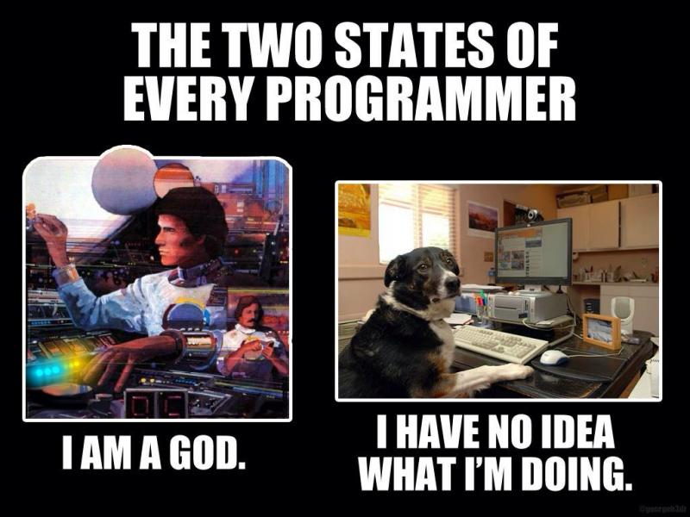
Working with Unity
Why and how should I GIT GUD at unity?
Imposter syndrome is perfectly normal and not to be overly concerned with
https://en.wikipedia.org/wiki/Impostor_syndrome

Slide 26
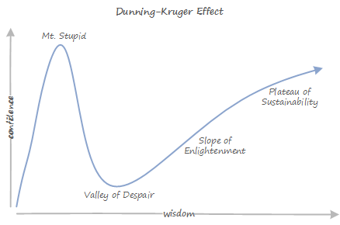
Working with Unity
Why and how should I GIT GUD at unity?
See also Dunning-Kruger Effect: ‘confidence in spite of knowing nothing / little’
https://en.wikipedia.org/wiki/Dunning%E2%80%93Kruger_effect
‘In the kingdom of the blind, the one-eyed man is king’
Erasmus (1466-1536)

Slide 27
Working with Unity
Why and how should I GIT GUD at unity?
Feel free to share your knowledge and skills with each other
In most fields, the way to really develop your skills is to teach/train other people
It forces you to get a really good handle on things
Don’t plagiarise though
Don’t had in other peoples’ work and claim it as your own
It’s fine to use my lecture materials, that’s what they are there for
If you use things from the internet / unity website
Reference your sources!

Slide 28

Working with Unity
Why and how should I GIT GUD at unity?

Slide 29

Working with Unity
Why and how should I GIT GUD at unity?

Slide 30
Working with Unity
Using Unity
Click on the Unity icon to launch unity and create a new project (or load an existing one)
If you don’t have an account already set up, set one up using your university email address.
Make sure you create projects in a drive you have access to, either
USB drive
D drive (remember to save / copy to Google drive or somewhere & delete afterwards)

Slide 31
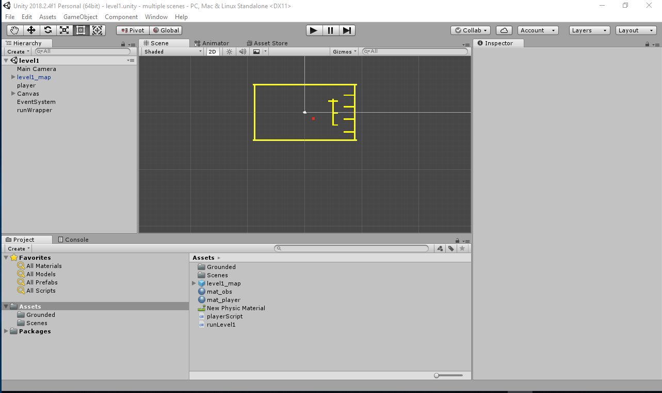
Working with Unity
Using Unity

Slide 32
Working with Unity
Using Unity
There’s six key parts to unity and they are all related
Project window (at the bottom)
This contains all the unity assets your project is using and (effectively) maps the contents of the folder your project is created in
It’s in two parts (directory listing on the left and files on the right), so it’s a lot like explorer
You can create new assets by right clicking on the right hand window and selecting create
You can search for assets with the search widget at the top
You can drag assets out of the project window and into the other windows (depending on what they are)

Slide 33
Working with Unity
Using Unity
Scene (centre) and hierarchy (left) windows
The hierarchy contains all the game objects in the current scene in a hierarchy view (parents and children)
The scene contains all the game objects in the scene in a 2D/3D view
The scene view is used to position game objects whilst the hierarchy is used to control the order of objects.
Objects can be manipulated in the scene view with the 6 icons in the top left corner of the display
Objects can also be manipulated through the inspector window and the transform component
The play, pause and step buttons trigger play mode (pressing it again will return to editor mode)

Slide 34
Working with Unity
Using Unity
Inspector window
This window contains details about whatever has been selected in the hierarchy, scene or project views.
If a game object has been selected, the inspector will contain a number of different components that the game object consists of
This is the fundamental way that unity works, it is a component based system
There is a lot of off-the-shelf functionality in components
There is also the scope to add new functionality through user-developed scripts
Use the add component button to add new components
Generally, components will expose variables allowing us to modify behaviour.
This can be done when games are running as well as in the editor, but when the application is stopped, the values will return to their editor state (though this is not the case for everything)

Slide 35
Working with Unity
Using Unity
Game window
This window shows the game running
While the game is running, you can use the scene view to inspect and manipulate game objects in the scene ☺
Generally, they will return to their editor settings when you stop play mode
This can be particularly annoying if you are playing the game to balance/tweak values, so bear that in mind

Slide 36
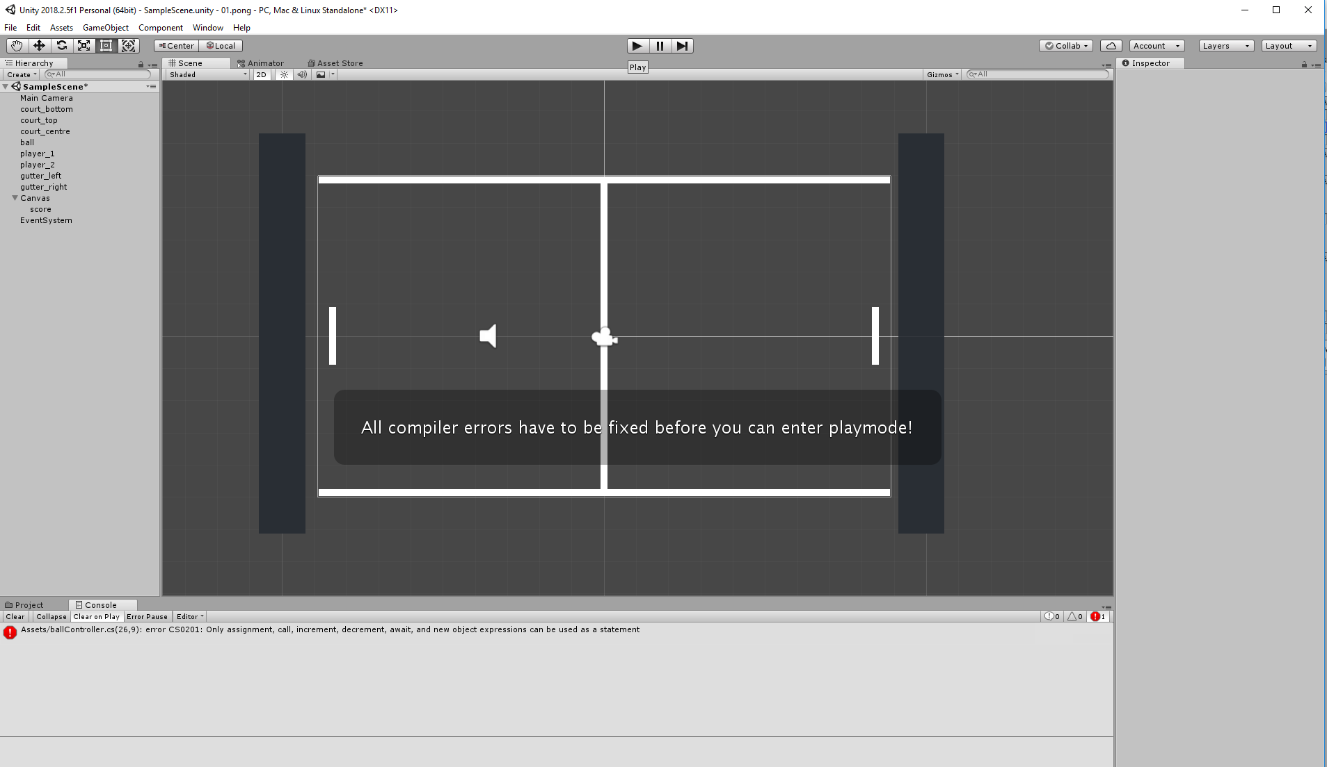
Working with Unity
Using Unity
Console window
This will show you errors, warnings and messages

Slide 37
Working with Unity
Using Unity
There’s a whole load more functionality and views in unity, if you investigate the menus you will find heaps more
If everything goes horribly wrong select
window->layouts->default to return to the standard unity layout.

Slide 38
Working with Unity
Using Unity
Unity uses a component-based approach which means a lot of the functionality we need for unity already exists, we just have to find the correct components for the game objects we’re using
However, we do need to write a bit of code to bring some functionality together
We will cover everything in the workshops, however, I would also recommend watching the short videos for beginner gameplay scripting (1-5,8,9 &10)
https://unity3d.com/learn/tutorials/s/scripting
They are only 5mins each
If you want to get really stuck into programming ahead of GAM160
https://www.lynda.com/C-tutorials/Learning-C/651201-2.html

Slide 39
Working with Unity
Using Unity
Safety
Don’t feel that you have to spend hours glued to a chair in front of unity
Take breaks when you need them
Watch out for eye strain and muscle strain / stiffness / ache
Not all developers like really high resolution screens or black on white text
Lower screen resolution
For visual studio
Darkula theme
https://docs.microsoft.com/en-us/visualstudio/ide/quickstart-personalize-the-ide?view=vs-2017
Tools->options->environment->general->color theme
Blue / Dark
Text scale (bottom left)

Slide 40
Working with Unity
Using Unity@home
I would assume you all have laptops and/or PCs
Can install unity on them
Make sure you use the same version as what we have in the Academy
Else you will spend a lot of time waiting for your projects to import
https://unity3d.com/get-unity/download/archive
We are on version 2018.2.6?

Slide 41
Working with Unity
Using Unity@home
Can keep your work on usb sticks / hard drives
Though very easy to lose
Get a key ring usb if you can
Keep regular back-ups!
We will look at version control next week

Slide 42
Break!

Slide 43
Making Platform Games in Unity

Slide 44
Making Platform Games in Unity
Your first assignment is to make a platform game in Unity
Details are on learning space
https://learningspace.falmouth.ac.uk/course/view.php?id=3095

Slide 45
Making Platform Games in Unity
Your first assignment is to make a platform game in Unity
We will spend the next 3 weeks looking at the components of platform games
Use these workshops to build your own game based on the source code and techniques presented
Components
Platformer 101: running, jumping and falling (Me)
Hazards, platforms and death (Me)
Camera control and larger levels (Jamie)
Implementing ‘lock & key’ style puzzles (Jamie)
Goal setting, detection and implementation (Jamie)
Working with multiple levels (Jamie)
Building standalone games (Me)
UI & Wrapper (Me)

Slide 46
Making Platform Games in Unity
Building a level in Unity

Slide 47
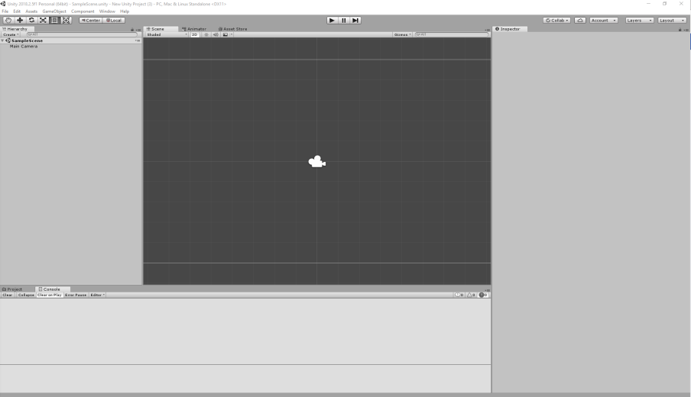
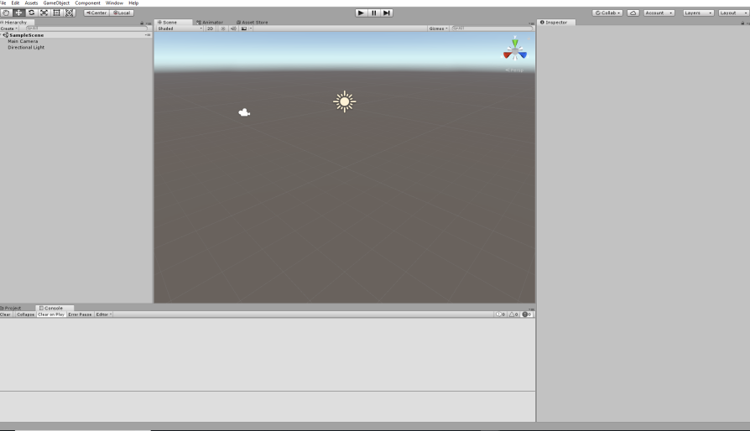
Making Platform Games in Unity
Building a level in Unity
Let’s start up unity and make a new 2D project
The one on the right is a 3D project, so if yours looks like this, have another go.

Slide 48
Making Platform Games in Unity
Building a level in Unity
The thick white lines on the scene are the boundaries for the camera, we can use those as a guide

Slide 49
Making Platform Games in Unity
Building a level in Unity
Where the camera currently is, is the origin of the screen, it’s at 0,0
Going up is the Y axis
Going left to right is the X axis

Slide 50
Making Platform Games in Unity
Building a level in Unity
Go to the Hierarchy window, press RMB and select 3DObject->cube
Use the scale widget to stretch the cube into the top line
The line is very dark (welcome to PBR)
Goto the project and create a new material and give it a nice nice name
RMB Create->Material
In the inspector, change the shader to Unlit->Color and make it a nice colour of your choice
Select your cube, the find the mesh renderer in the inspector, and click on materials, select the target next to Element 0 and choose your new material

Slide 51
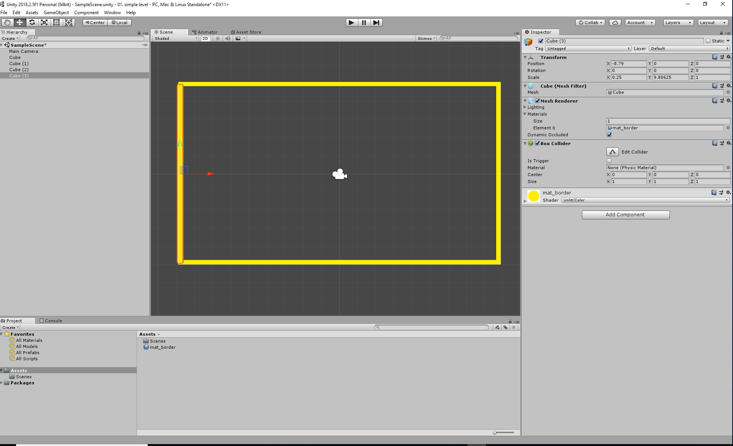
Making Platform Games in Unity
Building a level in Unity
We can use this approach to draw a ‘box’ for the level to stop the player from falling out of the world

Slide 52
Making Platform Games in Unity
Add a player to the level

Slide 53
Making Platform Games in Unity
Add a player to the level
The player is going to be another cube
Let’s make it small & red

Slide 54
Making Platform Games in Unity
Add a player to the level
The player is going to be another cube
Let’s make it small & red
To make the player move and be controllable, we need to add some stuff:
Add a CharacterController component to the player
Click on Add component
Type ‘character controller’ in the box
Select the character controller

Slide 55
Making Platform Games in Unity
Add a player to the level
The player is going to be another cube
Let’s make it small & red
To make the player move and be controllable, we need to add some stuff:
We need to write a script that will link your input to the character controller
Click on Add component again
Select new script & give the script a name, like player
Double click on the player script in the script widget to bring up VisualStudio
There will be a short delay ....

Slide 56
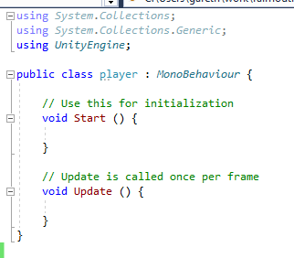
Making Platform Games in Unity
Add a player to the level
This is the default file you get when you add a script to a unity project.
The using statements at the top allow your script to reference other functions and classes.
Most of the unity’s functionality is in UnityEngine.
https://unity3d.com/learn/tutorials/modules/beginner/scripting/scripts-as-behaviour-components?playlist=17117

Slide 57
Making Platform Games in Unity
Add a player to the level
Unity is object oriented and uses classes to define data and functions.
All the unity scripts derive functionality from MonoBehaviour
https://docs.unity3d.com/ScriptReference/MonoBehaviour.html

Slide 58
Making Platform Games in Unity
Add a player to the level
Unity scripts have several important functions
Start() is called when a game object is enabled in a scene
Update() is called every frame, if the behaviour is enabled
https://docs.unity3d.com/ScriptReference/MonoBehaviour.html

Slide 59
Making Platform Games in Unity
Add a player to the level
The player is going to be another cube
Let’s make it small & red
To make the player move and be controllable, we need to add some stuff:
We need to write a script that will link your input to the character controller
We need to write some code
Here is some example code
https://docs.unity3d.com/ScriptReference/CharacterController.Move.html

Slide 60
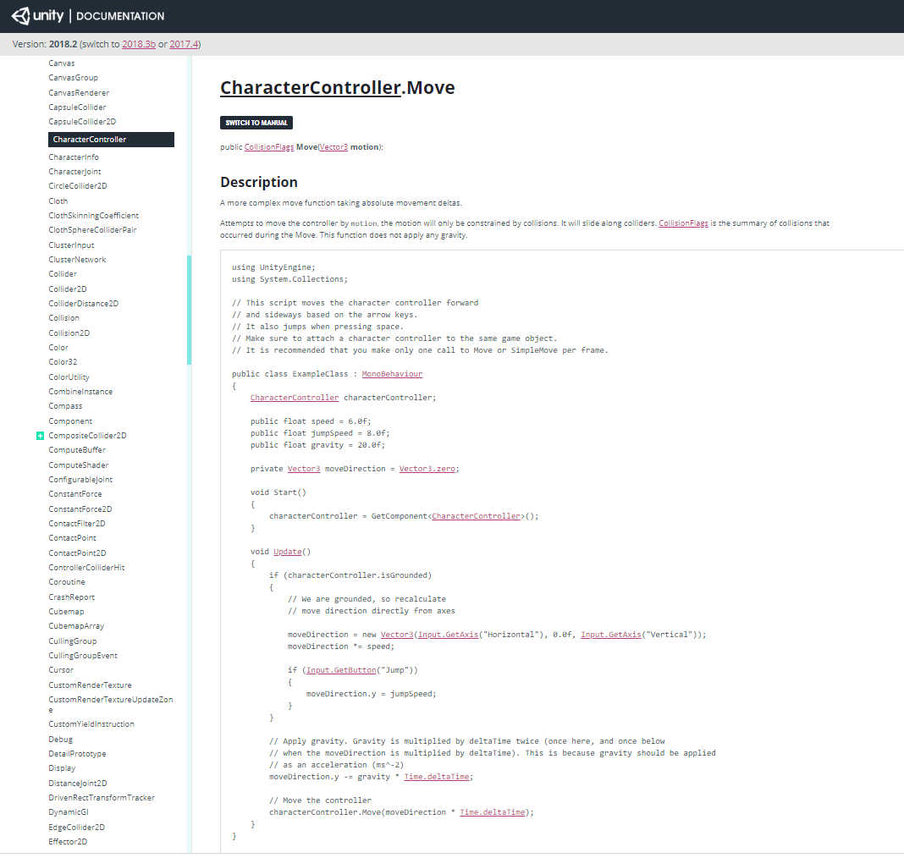
Making Platform Games in Unity
Add a player to the level
The player is going to be another cube
Let’s make it small & red
https://unity3d.com/learn/tutorials/topics/scripting/variables-and-functions?playlist=17117
https://docs.unity3d.com/ScriptReference/CharacterController.html

Slide 61
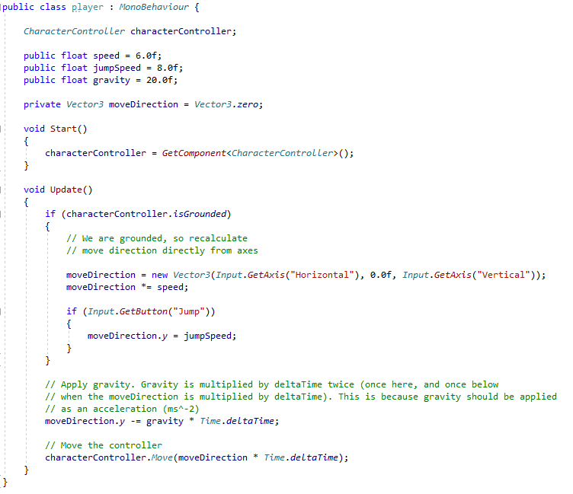
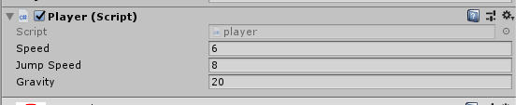
Making Platform Games in Unity
Add a player to the level
Making variables public will expose them into the inspector window.
This means you can change their values while the game is playing to balance on the go.
However, these changes are normally lost when you stop playing, so remember them or write them down
(There are exceptions and ways to get round this)
https://unity3d.com/learn/tutorials/topics/scripting/variables-and-functions?playlist=17117
https://docs.unity3d.com/ScriptReference/CharacterController.html

Slide 62
Making Platform Games in Unity
Add a player to the level
GetComponent<> allows you to get any component in a gameobject, including other scripts.
This is the core functionality of unity
https://unity3d.com/learn/tutorials/topics/scripting/variables-and-functions?playlist=17117
https://docs.unity3d.com/ScriptReference/CharacterController.html

Slide 63
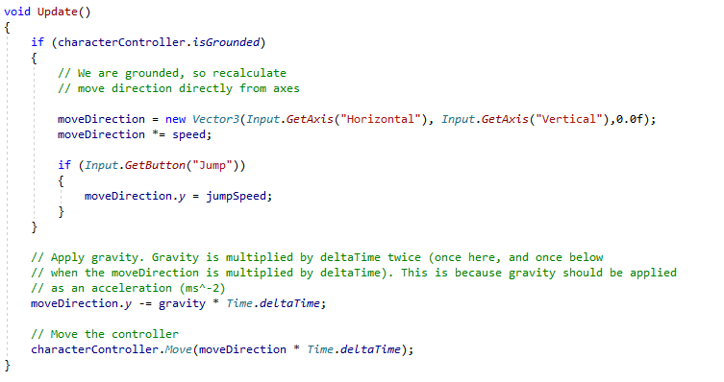
Making Platform Games in Unity
Add a player to the level
Input is Unity’s input system and it can be accessed from
[Edit->Project Settings->Input]
This is also in the splash screen for unity apps, so using getaxis() and getbutton() means your game will automatically deal with user input re-assignment
https://unity3d.com/learn/tutorials/topics/scripting/variables-and-functions?playlist=17117
https://docs.unity3d.com/ScriptReference/CharacterController.html

Slide 64
Making Platform Games in Unity
Add a player to the level
We need to change the Unity code so that ‘Vertical’ is applied to the Y component rather than Z as the 2D screen is X/Y (like maths at school
In 3D the X/Z plane is the floor
https://unity3d.com/learn/tutorials/topics/scripting/variables-and-functions?playlist=17117
https://docs.unity3d.com/ScriptReference/CharacterController.html

Slide 65
Making Platform Games in Unity
Add a player to the level
Time.deltaTime is used by Unity for dealing with frame rate inconsistencies
https://docs.unity3d.com/ScriptReference/Time-deltaTime.html

Slide 66
Making Platform Games in Unity
Add a player to the level
If we run this (big run icon), it kind of works
Don’t press up, the player will fall through the world

Slide 67
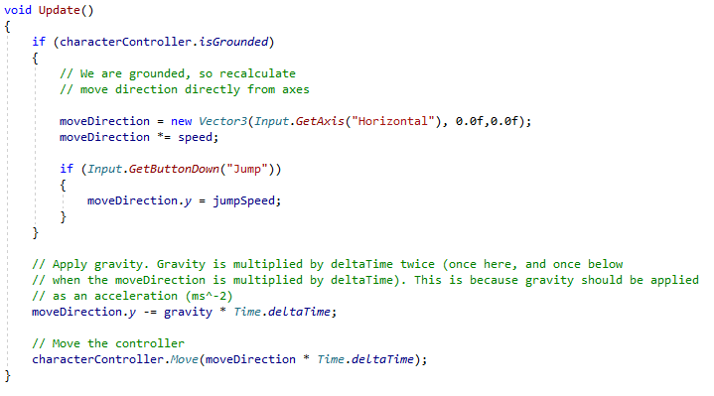
Making Platform Games in Unity
Add a player to the level
If we run this (big run icon), it kind of works
Don’t press up, the player will fall through the world
Let’s fix this (and a few other bits)
Remove GetAxis(“Vertical”) and replace with 0
Make jumping only occur on button down events to stop the player jumping like a loon
https://docs.unity3d.com/ScriptReference/Input.GetButtonDown.html

Slide 68
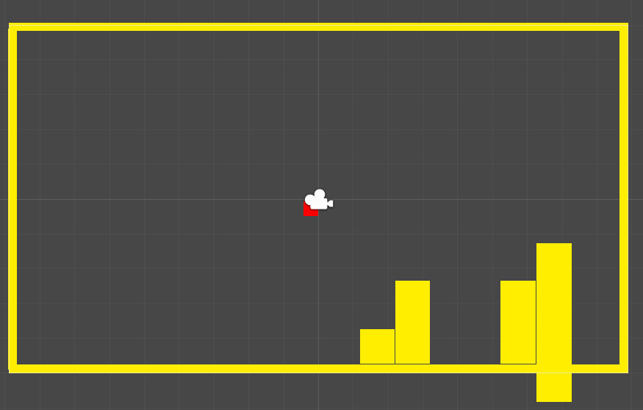
Making Platform Games in Unity
Now add some gameplay
Use your skill and judgement to make some obstacles for the player
Balance the player against the level so that level traversal requires some skill on your part ;)

Slide 69
Making Platform Games in Unity
Now add some gameplay
To make it easier to work with your level, let’s make all the obstacles a prefab
Prefabs get round the problem of run-time changes being reset by allowing you to save the state of game objects
However, by saving the state of them, you can run into problems the next run of the game
Hint: don’t add the player to a prefab

Slide 70
Making Platform Games in Unity
Now add some gameplay
To make it easier to work with your level, let’s make all the obstacles a prefab
Choose ‘create empty’ in the hierarchy (when your game isn’t running) and put all the obstacles in it
Drag the container into the assets folder on the right of the project display
This will make it a prefab and it will turn blue in the hierarchy

Slide 71
Making Platform Games in Unity
Now add some gameplay
To make it easier to work with your level, let’s make all the obstacles a prefab
Now run the game and move the obstacles around
If you press apply in the inspector window, the changes will be saved – like magic

Slide 72
Making Platform Games in Unity
Now add some gameplay
To make the player look closer to the world, set the skin width to 0.01 from 0.08.

Slide 73
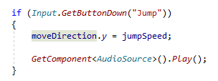
Making Platform Games in Unity
Now add some sound
Let’s find some audio
https://freesound.org/people/juskiddink/sounds/140867/
Download and drop into unity project window (right-hand side)
Add an audio source to the player game object
Drag the wav file into the audioclip
Disable play on awake
In the player code

Slide 74
Conclusions

Slide 75
Conclusions
Hopefully, this should have been fairly painless
About unity
Unity’s philosophy is all about having a lot of technology options that allow you to spend your time experimenting with making games, rather than implementing technology
Unity is all about gameobjects that can contain components to deliver different functionality
Scripts are a kind of component and have update() functions to do stuff
Scripts use GetComponent<>() to access components in their gameobject
Prefabs are great, when you use them right

Slide 76
Questions

Slide 77
Next week
Platform games pt II: hazards, traps and platforms
Version control 101

